Slide 1

BS1220: Introduction to Software Design and Development
Week 2: Hybrid Session 1

Slide 2

Hybrid Session 1
This Week’s Content
Variables
Data Type Recap
Creating Variables in Python
Assignment and Operators
Lists

Slide 3
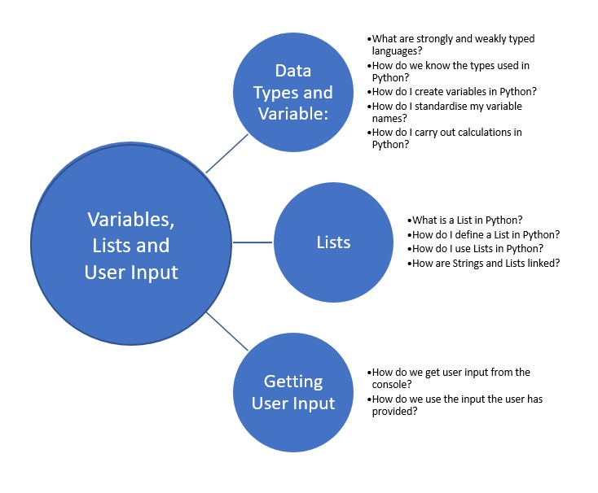
This Week

Slide 4
2.4: Variables
“a symbolic name given to an unknown quantity that permits the name to be used independent of the information it represents” (Techopedia, 2017)
Generally, have 4 attributes:
Identifier
Data Location
Type
Value

Slide 5
Defining Variables
In Python:
variable_name = <<value>>
For example:
my_name = “Claire”

Slide 6

PEP8 Key Considerations
Never use O or I as single letter names
1
Use descriptive names which makes it clear what the variable represents
2
Use lowercase word(s)
3
Words should be separated with underscores

Slide 7

Demo
Creating variables within Python

Slide 8

Operators Worksheet
Your tutor will post a copy of the worksheet within your Teams channel

Slide 9
Floating Point Accuracy
In PyCharm, enter the following code:
What output do you get?
float_number = 1.0 + 0.000000000000001
print(float_number)

Slide 10

Floating Point Accuracy
In PyCharm, update your code to the following:
What output do you get now?
float_number = 1.0 + 0.0000000000000001
print(float_number)

Slide 11
Why do you think you get the “wrong” answer?
https://docs.python.org/3/tutorial/floatingpoint.html

Slide 12
2.6: Lists
Special type of Variable
Holds multiple values
Collection of related data

Slide 13
List Example
Index | 0 | 1 | 2 | 3
Content | “alice” | “bob” | “charlie” | “dave”

Slide 14

Demo
Creating and using lists in Python

Slide 15

List Operations Crib Sheet
Complete the list operations crib sheet available within your Teams Channel

